Slide 1
Pedagogical transformation grant
Year 2: July 2015 to August 2016
Presentation to the Hewlett Foundation
16th March 2016

Slide 2
Discussion
Grant Context (30 mins)
National
Institutional
Pan African
Project Outcomes / Impact (1h.30)
By institution
PAR Agenda update
Communications update
Financial update
Grant Mitigation Strategies (30 mins)
Steering Committee
OER Convening
Evaluation TOR / Questions

Slide 3
OER Africa Pedagogical Transformation Grant
Location
Description
KENYA:
Africa Nazarene University
OER Africa will contribute to mainstreamed engagement with OER to improve both the content and the delivery of higher by academics through active support to institutional policies & procedures
TANZANIA:
Open University of Tanzania
SOUTH AFRICA:
University of Pretoria
University of the Free State
Notes:
Extensive change in institutional practice is required to transform higher education provision on the continent. Through more focused interactions, OER Africa plans to move engagement with OER from a few isolated projects to a mainstream institutional activity in which academics routinely look for OER to integrate into their emerging curricula, share back new and re-versioned OER as a matter of course, are supported in this process by institutional policies and procedures, and thereby contribute to the kind of educational transformation described above.
If this process of change is accompanied by rigorous research and sustained advocacy (that involves the institutions themselves in sharing their experiences), it can then be used to present to key decision makers (at a governmental level) and university administrators (such as senior management and Faculty Deans), practical evidence of the kinds of policy, regulatory, systemic, and cultural changes needed to effect the changes in pedagogical practice that higher education experts routinely discuss, but seldom implement on any significant scale.
This practical evidence can then be used to trigger broader processes of change by providing higher education decision makers clear guidance about the program of action needed to implement the types of institutional changes that broader social pressures are increasingly forcing them to consider.

Slide 4
The Context
30 mins

Slide 5
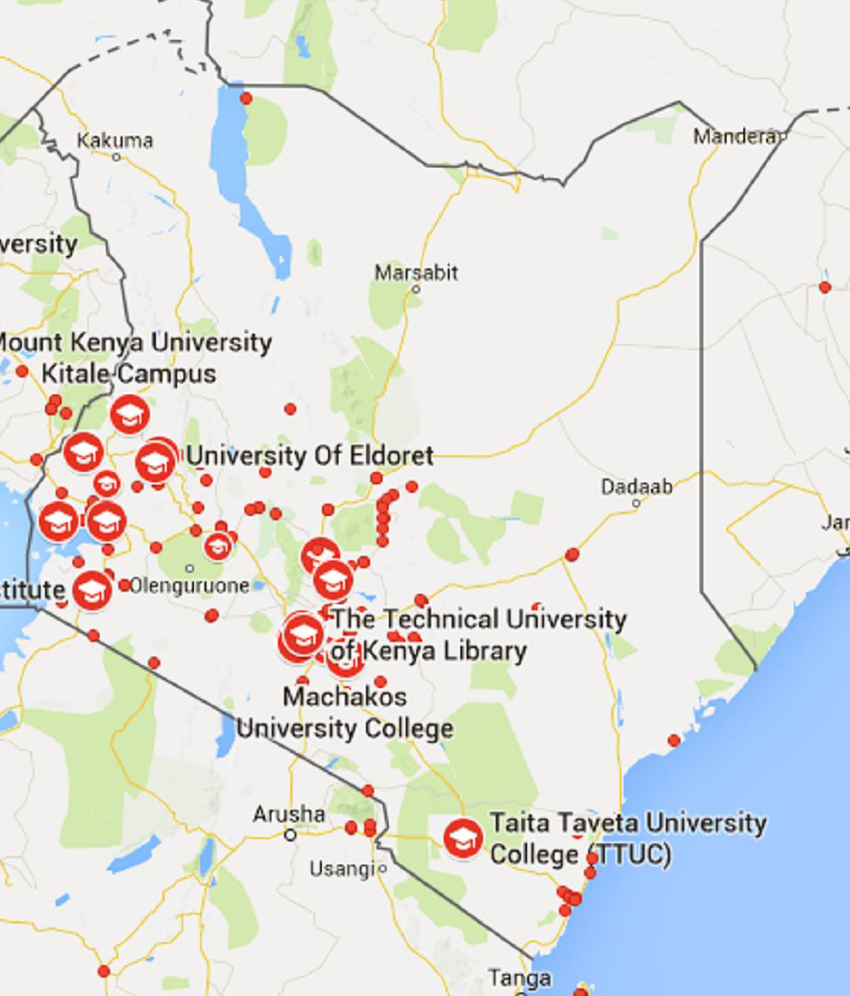
Kenya
Largest university education system in East Africa.
53 universities
6 public universities in 2003; 22 in 2013.
17 Private universities and 12 more awaiting credentials
9 constituent colleges of public universities and 5 of private universities.
Notes:
The landscape of higher education provision in Kenya has changed dramatically:
more players and a greater diversity of modes of provision
national task force exploring the establishment of a national Open University
For ANU, this means that students have a much greater range of options in a much more competitive environment.
So do faculty
ANU has tried to respond by offering a wider range of learning options but, as these have not always been thought through carefully enough and the necessary budgetary, system, policy and human resource strategy changes effected, tensions have grown within ANU between
the interests of students (many of whom are now clearly not getting a good deal as they have access often only to outdated and inadequate learning resources and decentralised support);
staff (much of the excitement and enthusiasm encountered in 2013 has been lost as staff feel their work commitments have grown but their remuneration has not) and
the institution (which sees declining demand for the services offered at its main campus, concerns raised by the national regulator about the quality of provision at satellite campuses and a core management team whose experience is primarily related to contact provision not resource-based forms of ODeL provision).

Slide 6
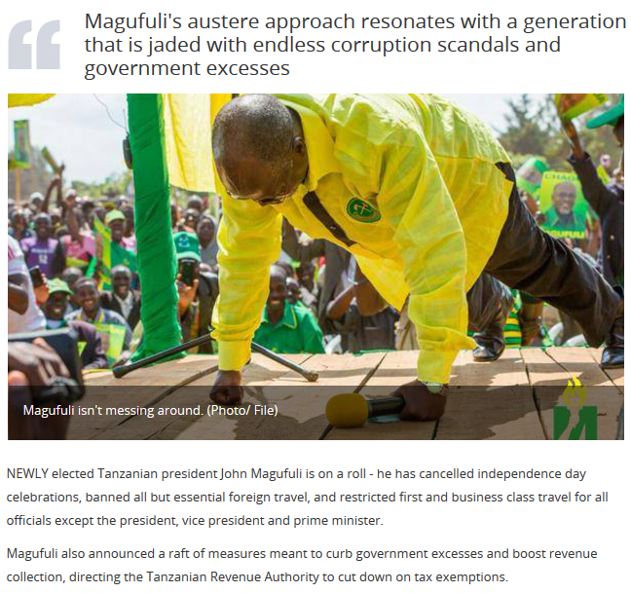
Tanzania
#WhatWouldMagufuliDo
33 universities
12 public universities
21 private universities
Notes:
At a national level, there has been a change of President, although not of the ruling party. The new incumbent has instituted wide sweeping changes that affect all National Universities. These include: restrictions on institutional budgets, academic travel and various academic allowances, dissolution of all contract posts, and new regulations around institutional banking, to name a few.
It is also reported that all appointments of new university staff must be channeled through government processes and may take up to 9 months to be approved. The situation is also unclear with respect to personnel secondments, as it appears that University staff are treated as government employees who may be redeployed elsewhere.
The implication for the collaboration with OUT is that there are fewer staff, who are under more time and financial pressure.
Source: http://www.tcu.go.tz/index.php/register-of-universities

Slide 8
HE Landscape in Africa
Legacy of SAPs / Bantu Education
Lack of differentiation within the system
Reluctance to tackle systemic issues
Fear of ‘researching’ innovation
If inertia is to be overcome, there is real need for conversations about ‘what is possible’
OER is a catalyst / entry-point for conversations about pedagogical transformation
Notes:
Euphoria of independence meant Golden Era (70s); govt and donor support
SAPs (80s) - Africa obligated to ‘choose’ between HE and basic education;
Result included brain drain, structural under-funding,
Painful recovery (90s)
double-intakes / donor funded projects (e.g. unaligned IT systems at Makerere) / melding of all HE / glorification of the degree
2000s – struggle to meet needs of growing and differentiated student base / societal expectations, ‘development’ needs
fear of failure / implosion
connectivity and opportunities for blended / online / resource based learning
HE in Africa is political – no immediate gains for politicians and long-term headac

Slide 9
Project Outcomes
1h30 mins

Slide 10
ANU – Key Activities
A policy framework that supports Open Distance and electronic Learning (ODeL)
An organizational architecture that supports ODeL provision and OER deployment
Examples of and reflective reports on workshops initially offered by OER Africa for core ANU staff, subsequently adapted and run by core ANU staff for other ANU staff as well as representatives from other institutions in the region

Slide 11
Potential Risks - ANU
Growing tension between the interests of students, staff, the institution and the core management team
Loss of Key Personnel
If the nature of quality ODeL provision is not well understood outside of the dedicated department, and if the activities of that department are not clearly aligned with the strategic objectives of the institution and resourced accordingly, OER mainstreaming will not gain traction because the ODeL provision it was intended to support is seen as a sideline and not a core business activity.
Notes:
Students: clearly not getting a good deal as they have access often only to outdated and inadequate learning resources and decentralised support
Staff: early excitement and enthusiasm encountered in 2013 dissipated as staff feel their work commitments have grown but their remuneration has not
Institution: sees declining demand for the services offered at its main campus, concerns raised by the national regulator about the quality of provision at satellite campuses
Core management team: their experience is primarily related to contact provision not resource-based forms of ODeL provision).
Despite obvious synergy between OER and ODeL provision (RBL), if the nature of quality ODeL provision is not well understood outside of the dedicated department, and if the activities of that department are not clearly aligned with the strategic objectives of the institution and resourced accordingly, OER mainstreaming will not gain traction because the ODeL provision it was intended to support is seen as a sideline and not a core business activity.

Slide 12
Mitigation - ANU
Focus on helping the institution to develop a new business model more appropriate to the changed environment
Effective utilization of its Enaz LMS to support all forms of provision – contact, part-time, workplace-based and distance –central to this – and will require a pedagogic shift in all forms of provision towards activity- and resource-based approaches
The new system will need to help the institution make informed choices about what forms of provision to offer in what contexts to be both effective and efficient and to resource accordingly in ways that reflect the best interests of students, staff and the institution.

Slide 13
Project Outcomes / Impact: ANU
A deepened understanding of how OER practices can support sustained transformation of teaching and learning in African universities.
Exposure to high quality OER and the freedom to adapt will excite and engage some faculty
Teachers already engaged in resource-based learning will take OER in their stride.
Mainstreaming this process is much more complicated.
If it was simply a case of finding a few existing OER and giving these to students instead of textbooks or in addition to prescribed commercial textbooks there would be little problem but also little pedagogic change.

Slide 14
Project Outcomes / Impact: ANU
Accumulated understanding of how OER practices and policy can support transformation of teaching and learning in African universities is widely shared and is incorporated into advocacy.
Over our engagement with ANU, other Kenyan institutions have approached the ANU IODL for advice, including the commission exploring the possibility of an open university in Kenya
Two external universities also participated in a workshop run by OER Africa for ANU.
A critical new activity at ANU inspired by engagement with OER Africa is the new action-research-based PGCE programme. We will seek to help ANU to formalise this into an article for an open access journal like Irrodl.
Notes:
PGCE – Post Graduate Certificate in Education
IRRODL is now the International Review of Research in Open and Distributed Learning. Read more about our name change and our growing status as one of the leading journals in learning technologies and online pedagogy. (see http://www.irrodl.org/index.php/irrodl)

Slide 15
OUT – Key Activities
A comprehensive OER policy initiated which references / augments existing related institutional policies
A Digital Fluency Course for Academics (comprising five modules) to be designed, developed, mounted online, and piloted.
Upgrade OUT Open Repository / Establish an OUT OER publishing framework, process and OER support team for open courses at OUT.
PAR Agenda defined and researcher/s identified to complete research

Slide 16
Potential Risks - OUT
Significant turn-over of staff playing a key role in the OER Africa collaboration including VC, DVC (Academic), and the Library Director.
Mitigation:
Good relationship established with the new appointees prior to their promotion, and they remain OER champions.
PAR research agenda now being driven by the acting DVC (Academic) - a positive shift
Effort and energy to retain contact with and focus on the project with those who have left the university
Energy and care to maintain interest & support of those in newly elevated positions.
Notes:
Staff changes include: the VC, the DVC (Academic), and the Library Director.
The latter 2 persons have been promoted with the University structure and continue to be OER champions.
The top management appointments at universities in Tanzania are essentially political and made at a government level, which means that institutional transition is slow while the new VC consolidates his new team.
In early 2016, the senior staff member who was driving the PAR agenda moved to another institution.
3 of the team leaders of the Digital Fluency modules have been transferred from the University to other governmental organisations.
One of these team leaders was also a driving force in the OER course conversion team.
In each case, they have undertaken to continue their involvement in the OUT Digital Fluency piloting.
In each situation, we have responded to staff changes by adopting a flexible approach and seeking guidance from within the OUT on who appropriate staff would be to liaise with for different purposes.

Slide 17
Potential Risks - OUT
Tanzania’s change of President, along with wide sweeping changes that affect all National Universities.
restrictions on institutional budgets, academic travel, academic allowances, dissolution of contract posts, etc.
new university staff to appointments of be channeled through government processes
Secondments
Mitigation:
support OUT staff in achieving the project outcomes within their environmental constraints through collaborative brainstorming
seek to overcome challenges as they arise.
Notes:
Changes:
government processes (up to 9 months approval process).
with respect to personnel secondments, it appears that University staff are treated as government employees who may be redeployed elsewhere.
Mitigation: Our current influence in the national situation is non-existent.
it appears that some of the new restrictions may be relaxed over time, as universities by their nature are likely to have different needs requiring different processes to regular governmental organisations.
Support to OUT staff requires awareness and sensitivity with respect to the national environment, and collaborative brainstorming with both the OUT personnel involved and also with the OER Africa working group, in order to overcome challenges as they arise.

Slide 18
Potential Risks - OUT
OUT staff mandated to accelerate movement towards increased open practices and OER production and publishing .
pressure is evident in increased time to complete tasks and tendency to tackle unscheduled activities that present as critical and immediate
constraints of time and of available skilled personnel
Mitigation:
Acting DVC tasked by VC to take on institutional OER Africa liaison role / lead an internal OER Africa collaboration committee to coordinate activities
Notes:
As members of the national ODL university, the OUT staff are mandated to accelerate movement towards increased open practices and OER production and publishing (despite the institutional and national environment described above).
This pressure is evident in increased time to complete tasks falling within the OER Africa collaboration, on top of their regular duties.
it is true to say that not much project work gets done at OUT in between site visits
staff tend to jump to tackle unscheduled OUT tasks that present as critical and immediate
Mitigation: Having acknowledged the constraints of time, available skilled personnel, and the university ODL mandate, we nevertheless anticipate a move to better scheduling and attention to collaborative tasks with the
acting DVC taking on the OER Africa liaison role for the institution.
She has been tasked by the new VC to lead an internal OER Africa collaboration committee to coordinate activities from the OUT side.
This should also assist with maintaining the momentum of the project work between site visits.
,

Slide 19
Project Outcomes / Impact: OUT
A deepened understanding of how OER practices can support sustained transformation of teaching and learning in African universities.
OUT has embraced this understanding in theory. What needs to be worked on is implementing a sustained practice within the environmental constraints, which includes traditional practices in distance learning
Availability of ICTs has prompted investigation of a more interactive teaching and learning approach - a challenge to staff accustomed to keeping students at a distance
Discussion around rewards for mounting OER courses initiated to mirror previously implemented reward structures around mounting courses online

Slide 20
Project Outcomes / Impact: OUT
Accumulated understanding of how OER practices and policy can support transformation of teaching and learning in African universities is widely shared and is incorporated into advocacy.
OUT proud of its position as the region’s first ODL institution
Sees the Digital Fluency OER course as a significant contribution to staff capacity building in institutionalising OER and ICT, not only at OUT, but also regionally.

Slide 21
UP
15 mins

Slide 22
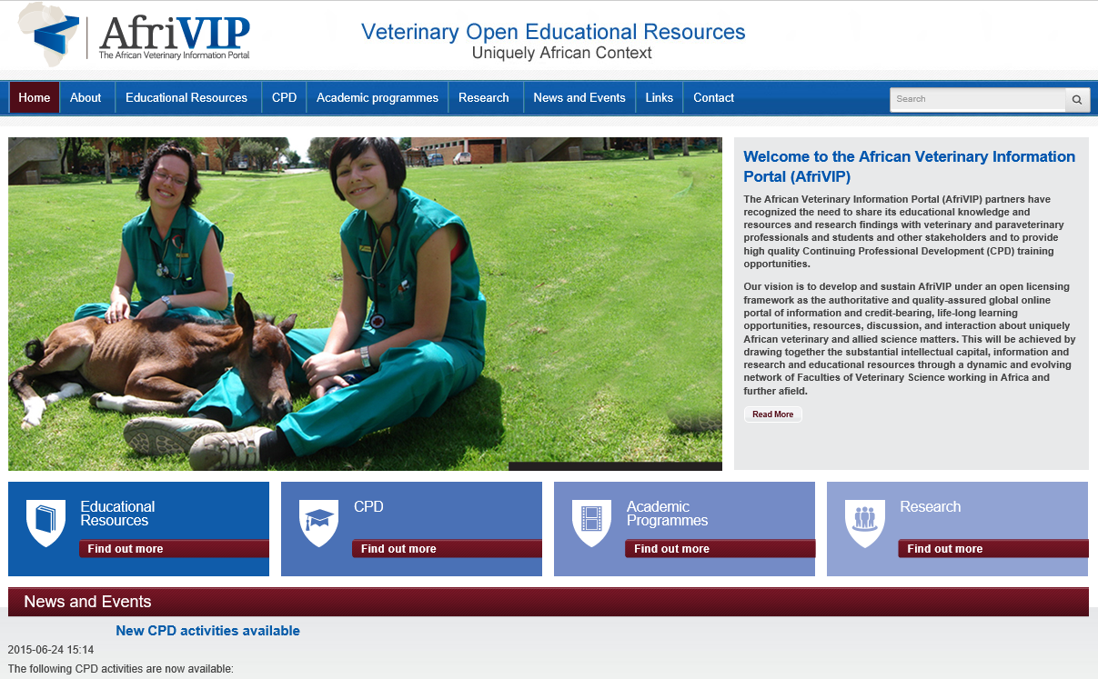
Notes:
Phase I: (2012-2014): OER Africa worked closely with Department of Veterinary Tropical Diseases to;
Conceive an education model embracing technology and ‘openness’
Provide awareness of OER to staff within the wider faculty
Construct AfriVIP, an online repository of quality veterinary teaching and learning resources, as an initial mechanism to achieve the vision of a blended and open learning environment.
By the end of phase I, AfriVIP was launched (http://www.afrivip.org/) containing predominately CPD resources.
Phase II commenced in 2015 and will run to early 2017.

Slide 23
Phase II Vision
Research how OER might support transformation in teaching and learning. - activities have been designed in three particular areas to elicit data for the research:
Expand AfriVIP repository and enhance CPD experience, but also design ways to use the database for teaching both undergraduates and postgraduates.
Encourage faculty staff and students beyond Veterinary Tropical Diseases Department (through advocacy and training), to adopt and contribute OER for development of courses.
Use AfriVIP to develop partnerships with other faculties of Veterinary Science across the region to create and share OER.
From lessons learnt during phase II, provide the VC with a suggested revision of the institutional IP policy.

Slide 24
Phase II Targets
Continuing Professional Development (CPD) courses being offered by Onderstepoort will be developed using OER, with at least five new courses operational by the end of the grant.
The newly established AfriVIP Portal will be systematically integrated into the delivery of at least four different undergraduate and postgraduate programmes at the Faculty, as a primary source of educational materials for these programs.
A revised draft institutional policy on intellectual property will have been developed under the auspices of the Information Governance Committee, based on the lessons learned from the work at Onderstepoort.

Slide 25
Phase II Targets
Planning engagements with at least one other Faculty at the University of Pretoria will have been concluded, with commitment from that Faculty for integration of OER into its educational activities.
At least two other Faculties of Veterinary Sciences from Southern and/or Eastern Africa will be actively contributing resources to the development of the AfriVIP Portal.
A detailed collaborative project will have been successfully designed, incorporating at least 4-5 of the Faculties of Veterinary Science participating in the Regional Deans’ meeting.
Notes:
1. OER Working Group has been formed with representatives from each department and also representation from library that convenes 4 times a year. The most recent minutes show numerous OER Activities in process including the development of an workflow to quality assure OER before release.
2. Within departments various teaching resources have been identified and many have been loaded into the AfriVIP database, not as CPD but teaching resources. South African Veterinary Association (SAVA) has contributed 20 CPD readings with questions for distribution to help set up the automated points scoring mechanism. Once working they promise more. OER Africa is helping with the development of the functional specs
3. Two projects have commenced that target student contributions. Students were trained to use phones to document clinical procedures and experiences in the field.
4. Meeting with 4 regional deans (Namibia, Zimbabwe, Edwardo Mondelane and Soikoine) took place during 2015 and a draft project proposal was developed. This was followed up by visits to Mozambique and Tanzania.
5. Contact has been made with School of Health Systems and Public Health, and now potentially with Faculty of Education to investigate projects and initiatives around the use of OER.
6. Feb 2016. - A training programme was developed and deployed to support staff create open blended learning programmes that suit the block system.
A PAR research agenda has been developed that attempts to measure impact of blended open block teaching methods and UP/OP staff identified to coordinate the study

Slide 26
Phase II Strategy & Progress - Regional Deans Project
AfriVIP - central repository for OER generated by different institutions
Commitment to use official student assignments to generate Openly licensed teaching resources to share.
Notes:
The intention is to use AfriVIP as a central repository for OER generated by different institutions. Each with their own user interface but sharing the same backend resources. All four of the institutions consulted said they would use official student assignments to generate the OER teaching resources. Progress has been slow however although a strong relationship has been built with Edwardo Mondelane and Soikoine. Namibia too, after a credentialing crises, seems to be back in action.

Slide 27
PAR
Supposed Benefits
Block Teaching
Exclusive focus on topic
Time for students to master knowledge and skills
Technology
Allows for anytime/anywhere access to learning resources and activities
Encourages alternatives to text-based resources
OER
Access to existing free, quality learning resources
Exposes developers to other teaching approaches
Forces different teaching methods to break monotony of lectures
Allows for diagnostics of student progress as captured in LMS
Opportunity to showcase staff and student generated resources beyond the university.
2015: 2nd year Vet. Sci. course to be taught in continuous, subject dedicated, blocks rather than teaching departmental topics in parallel.
Hoped that, when revising topics, departments would exploit technology, use inquiry-led methodologies and use OER
Research to ascertain what impact, either positive or negative, these new dimensions bring to the quality of learning.
Notes:
PRIMARY RESEARCH QUESTION: What effect does the teaching system have on the long-term performance of students in the Bachelor of Veterinary Sciences programme?
Research Team:
Education Innovation Unit: El-Marie Mostert and Marius Pienaar
Faculty of Veterinary Science: Dietmar Holm (Acting Deputy Dean) & others
OER Africa: Neil Butcher & Andrew Moore

Slide 28
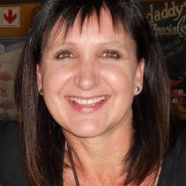
Recent developments
Linda van Ryneveld, Deputy Dean (Academics) and OP’s liaison person for this project, moved to the Faculty of Education.
Dietmar Holm is in the process of being appointed as Acting Deputy Dean and has taken on many of Linda’s duties, including coordinating our project.
The Dean, Darrell Abernethy, remains fully committed to our project, and has special interest in the results of the PAR.
Activities in the early part of 2016 focused on;
Ensuring we still had the support of management for the project
Preparing the Block Builders Workshop to capacitate staff in pedagogy, technology and OER.
Fine tuning the PAR agenda and locating research champions.
Notes:
Move of Linda van Ryneveld affords OER Africa an opportunity to expand awareness of OER and provides an additional campus to collect data for the PAR
Linda is an advocate of using OER and notes the Education Faculty is already constructing a course using OER.
Linda has expressed interest in using OER Africa support to drive these types of initiatives within the faculty.

Slide 29
UFS – Key Activities
First rounds of training/technical support on OER provided for at least 25 key academic support staff
Draft IP Policy developed for consultation
PAR Agenda defined and researcher/s identified to complete research
Unit for Language Development (ULD) Strategy completed and approved
At least 20 modules show evidence of incorporation of lessons learned from technical support in item 1

Slide 30
Potential Risks - UFS
Growing levels of disruption:
Impact of student protests and university closures on available finances and human resources
Impact of wider political process - policy and operational uncertainty have a negative effect on willingness to engage with activities beyond requirements of performance management reviews.
Departure of many skilled people and the appointment into management positions of people who do not necessarily have the requisite skills for the portfolio they occupy
Academic & research activities depleted by time spent on ‘political’ activities.
Notes:
The major challenge at UFS is the growing levels of disruption unfolding at the university caused by political processes. The most important disruption comprises student protests against a range of issues, a problem that UFS currently shares in common with many other South African universities. The protests have resulted in university closures, which not only disrupt academic activities, but are also having an effect on available finances and human resources as students pressurize the system to reduce university fees.
In addition, however, the wider political process in South Africa is also having a disruptive effect, as it creates both policy and operational uncertainty and also tends to have a negative effect on people’s willingness to engage with any activities that are beyond what is required of them for the purposes of performance management reviews. Sadly, broader political processes have resulted in the departure of many skilled people from the university and the appointment into management positions of people who do not necessarily have the requisite skills for the portfolio they occupy.
The most obvious consequence of the ongoing encroachment of national processes into academic activities is simply time wastage. Academic and non-academic staff spend a growing proportion of their time engaged in processes that add no value to the academic activities of the university, at the expenses of their capacity to teach more effectively and undertake meaningful research.

Slide 31
Mitigation Strategies - UFS
Mitigation:
Ensuring OER Africa supported activities are linked to institutional strategic objectives and initiatives is increasing traction
Retain a high level of flexibility to enable easy absorption of unintended disruptions without affecting the overall workplan
Sustain ongoing communication – including regular face-to-face visits – to maintain enthusiasm for the work we are doing together with the university.
Notes:
Several of these issues are beyond the control of OER Africa or our counterparts within the university, so there are limits to what mitigating strategies can be developed. The most important mitigation strategies currently are to:
Ensure that all activities being supported by OER Africa are linked to strategic objectives and initiatives already defined by the university, as this maximizes the likelihood of them being completed and sustained after the project concludes. All of the outputs and activities described above are linked in this way, which is increasing the traction we have.
Retain a high level of flexibility in our engagement to enable easy absorption of unintended disruptions without affecting the overall workplan. Linked to this, current plans are assuming ongoing disruptions in an effort to minimize their effect.
Sustain ongoing communication – including regular face-to-face visits – to maintain enthusiasm for the work we are doing together with the university.

Slide 32
Project Outcomes / Impact: UFS
A deepened understanding of how OER practices can support sustained transformation of teaching and learning in African universities.
Using OER to deliver the Multiple Literacies course
Assessing the extent to which a migration to e-learning and use of OER can help to displace the need for formal textbooks
Exploring what role OER can play in improving the UPP and the ULD
Examine the extent to which these models can potentially be shared with other universities by releasing UPP materials under open licences.
Notes:
Signs are promising that our work at the UFS will contribute significantly to this outcome.
Of particular interest will be:
Using OER to deliver the Multiple Literacies course which represents a highly ambitious attempt to tackle development of academic literacies in students without increasing the cost of delivery to the university and will effectively function as a MOOC.
Assessing the extent to which a migration to e-learning and use of OER can help to displace the need for formal textbooks, in the Module Makeover Project. This is of particular interest to the university given the significant increase in prices of textbooks since international publishers decided to standardize global prices for textbooks.
Exploring what role OER can play in improving the UPP and the ULD, which are already highly innovative programmatic/course-based approaches to supporting underprepared students entering the institution. It will also be worthwhile to examine the extent to which these models can potentially be shared with other universities by releasing UPP materials under open licences.

Slide 33
Project Outcomes / Impact: UFS
Accumulated understanding of how OER practices and policy can support transformation of teaching and learning in African universities is widely shared and is incorporated into advocacy.
documentation of interesting practices that are of use and value to others in Africa and around the world
if some of the more innovative work being done can be shared under open licences this will significantly aid OER Africa’s wider advocacy efforts.
Notes:
The above lessons should feed strongly into this outcome, enabling the documentation of interesting practices that are of use and value to others in Africa and around the world. If some of the more innovative work being done can be shared under open licences this will significantly aid OER Africa’s wider advocacy efforts.

Slide 34
PAR Agenda
15 mins

Slide 35
PAR Agenda (1)
General learnings
PAR in this context is challenging with respect to academics’ time constraints
Concept of PAR not necessarily well understood / internalised
Hoping that such internalisation = better course design / dev’t
Link between OER and pedagogical transformation is still not well understood by academics
Impact of political processes on HE is greater / different than we had anticipated (e.g. Magufuli & the $20 / SA disruptions)
Reluctance to formally research innovation

Slide 36
PAR Agenda (2)
At institutional level:
Institutionalization of OER cannot happen in isolation of pedagogical transformation
For PD to be embedded, it would be useful if 10% of research output by academics was on reflective practice
At OUT, the OER policy implementation plan is what will drive the pedagogical transformation process
Importance of understanding what other processes are at play and actively building complementarity, e.g. OER Africa and COL both working on OER at OUT

Slide 37
Comms update
15 mins

Slide 38
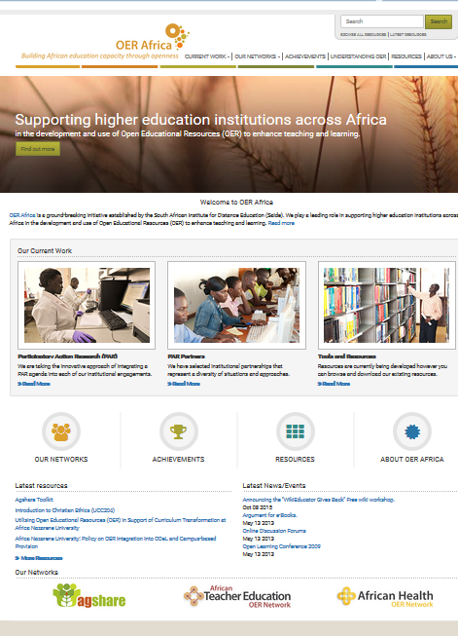
Communication Strategy
Maintain visibility of previous work
Highlight learnings emerging from current grant
Re-establish thought-leadership position re OER in Africa

Slide 39
stats

Slide 40
Visitor Overview (Aug 2014 – Jan 2016)
Notes:
A session is the period time a user is actively engaged with your website.
These are the Economics videos

Slide 41
Traffic Overview (Aug 2014 – Jan 2016)
Notes:
A session is the period time a user is actively engaged with your website.
These are the Economics videos

Slide 42
Resource Overview
Notes:
A session is the period time a user is actively engaged with your website.
These are the Economics videos

Slide 43
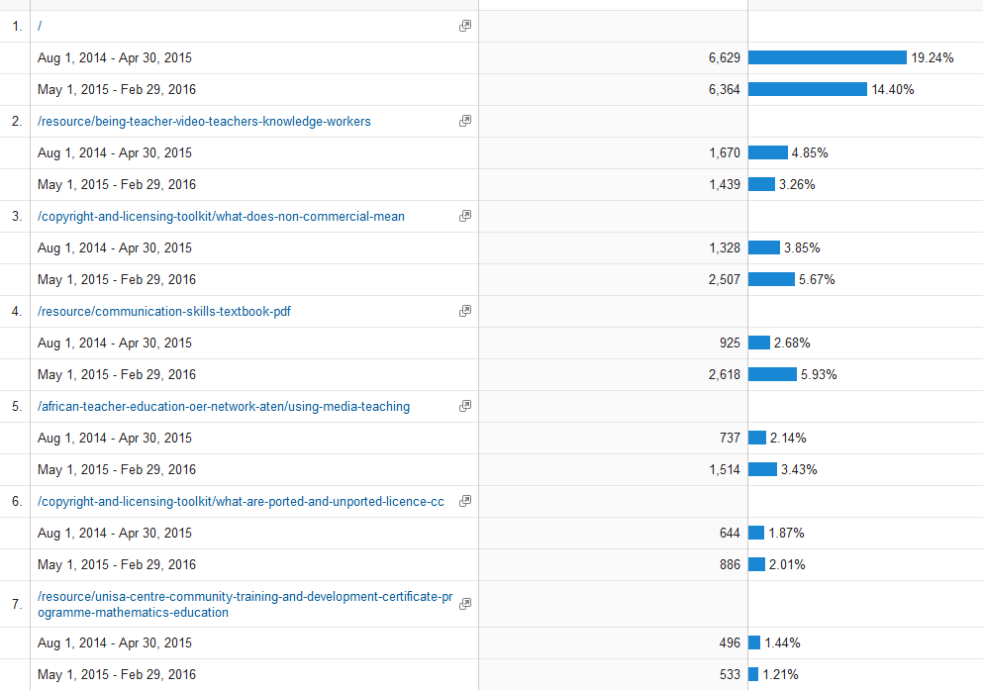
Top 10 Landing Pages
Notes:
Top Landing Pages

Slide 44
Device Overview
Notes:
Top Landing Pages

Slide 45
Top 10 Downloads
Agricultural Marketing Management Module | 438
An Introduction to Electronic Medical Records - Slides with instructor notes | 379
Understanding Web 2.0 and Its Implications for e-Learning | 309
OER Copyright and Licensing Toolkit | 272
Farmers Agribusiness Training Course | 251
Educational Technology for Effective Teaching: A Handbook for Educators | 235
Constraints to increasing agricultural productivity in Nigeria | 221
Agricultural Marketing and Price Analysis - Coffee | 177
Unisa Centre for Community Training and Development Certificate Programme in Mathematics Education (FET Band): Study Guide. Qualification code 70394: CMAS035 CMAS046 | 168
Supporting Teaching Practice: A Manual for Supervisors and Mentors | 158
Notes:
10 resources - How to compare

Slide 46
YouTube Videos Overview
Notes:
Showcase ‘best’ videos in the featured resources section.
ILS – new resources

Slide 47
Summary Aug 2014 – June 2015
 | Feb – Apr 2015 | May – July 2015 | Aug - Oct 2015 | Nov – Jan 2016
Total visitors | 14 438 | 12 792 | 14 840 | 10 219
New visitors | 12 205 | 10 850 | 12 561 | 8 599
Returning visitors | 2 233 | 1 942 | 2 279 | 1 620
Visitors from Africa | 7 214 | 5 721 | 7 322 | 3 951
Average time spent | 00:02:28 | 00:02:09 | 00:01:47 | 00:01:52
Pages per session | 2,81 | 2,26 | 1,92 | 2,06
Duration (3–10 mins) | 1 352 | 903 | 1 042 | 750
Page views | 40 502 | 28 907 | 28 530 | 21 080
Bounce rate | 58% | 67% | 68% | 72%
Direct traffic | 28% | 24% | 32% | 22%
Search engine traffic | 53% | 59% | 53% | 60%
Referral traffic | 19% | 17% | 15% | 18%
Total resources | 1 917 | 1 922 | 1 925 | 1 956
Resource views | 176 022 | 262 169 | 151 251 | 109 236
Resource downloads | 41 275 | 56 949 | 67 723 | 57 532
YouTube videos views | 96 029 | 88 238 | 87 631 | 88 217
Total videos | 345 | 345 | 345 | 345

Slide 48
Financial update
15 mins

Slide 49
Grant Mitigation Strategies (30 mins)
Steering Committee
OER Convening
Mid-term Evaluation

Slide 50
Role of the PAR Steering Committee
To ensure
that the Participatory Action Research (PAR) Grant awarded to Saide’s funded OER Africa initiative is effectively planned, implemented, monitored and optimally evaluated within the parameters of the relevant agreement/s with the funder;
that the strategies employed to achieve the grant objectives complement each other in the furtherance of an OER agenda;
regular reflection on the experiences of this project and the sharing of these reflections more widely as appropriate.

Slide 51
2016 Convening
Format
The convening will occur over 2 days with Day 1 being dedicated to an exploration of the two key themes, pedagogical transformation and participatory action research.
Day 2 will seek to consolidate lessons learned to date and integrate them into the planning for the remainder of the grant.

Slide 52
Objective - 2016 Convening
To discuss
What do we mean by pedagogical transformation and what should we be striving for given the context sketched out in this concept note?
What do we mean by PAR and what are its applications in higher education?
What kinds of pedagogical transformation are envisaged at each of the participating institutions and within what timeframes are these changes expected to occur?
In what ways can embedding effective OER practices support the envisaged pedagogical transformations?

Slide 53
Objective - 2016 Convening
In what ways can a focus on pedagogical transformation serve to embed effective OER practices into mainstream institutional activities and systems, rather than these practices operating parallel to the mainstream?
What are the experienced and anticipated barriers and enabling factors for the embedding of OER practices that serve the pedagogical transformation processes outlined in 3) and how can we mitigate the former and optimally harness the latter?
In light of the above, what roles can PAR play in supporting pedagogical transformation in higher education, both for the participating institutions and more broadly?
What useful lessons does this discussion elicit that might inform the work of OER Africa and its partner institutions?

Slide 54
Grant Evaluation
Methodology: Formative and illumanative
Review of key documents and emerging outputs of Grant activities;
Interviews (face-to-face and telephonic) with key stakeholders from OER Africa and participating universities;
Focus group sessions with key stakeholder groups within each university.

Slide 55
Evaluation Questions (1)
How do the various key stakeholders involved in the Grant define and interpret the conceptual terms ‘pedagogical transformation’, ‘OER practices’, and ‘PAR’? Are there any emerging discrepancies between these interpretations that might affect implementation of the Grant?
To what extent are the activities supported by OER Africa in participating universities, as well as any related activities making use of OER in those institutions, contributing to meaningful pedagogical transformation? Where they are contributing to pedagogical transformation, how sustainable is this likely to be? How can these activities be improved?
How strong is the buy-in by institutions to identified pedagogical transformation objectives? Is this buy-in from individual academics or bigger groups/departments?

Slide 56
Evaluation Questions (2)
Is the process of pedagogical transformation leading to any embedding of OER practices in modules or programmes?
What steps are being taken to institutionalize new approaches to pedagogy (either at faculty or institutional level) to ensure post-project sustainability?
Does PAR seem to be an appropriate research methodology to enable institutions to reflect on, and improve, their pedagogical practices, as well as to sustain OER practices?? What are its strengths and its limitations? How strong is the buy-in to this methodology?

Slide 57
Evaluation Questions (3)
Are the PAR research activities currently designed sufficiently robust in their design and implementation to enable critical reflection on, and improvement of, institutional pedagogical practices and embedding of OER practices? What can be done to further improve them in this regard?
What general lessons are emerging from the activities of the OER Africa PAR Grant that are worth sharing more widely?

Slide 58
Next steps (20 mins)
Hewlett Education Strategy for the Developing World
OER Africa possible considerations

Slide 59
Notes:
Hewlett OER Agenda
Interests for work in Africa / developing world given Hewlett dual focus on OER Infrastructure & Textbooks (e.g. Achieving the Dream grant to Community Colleges?

Slide 60
Some thoughts on Hewlett Education Program in Africa / Developing World
Need for a CoP to disrupt the current discourse (litany of woes) and build a critical mass of OER institutions
50/50 Institutional consolidation / embedding+ Transference of lessons learned (who in the region would our institutions wish to work with in order to build an OER CoP?)
Pedagogical & Curriculum Transformation: Materials Dev’t +curriculum re-design + Professional dev’t around Digital & Information Literacy (source, evaluate, use) for faculty
Notes:
We are making a difference / building links between projects, e.g. PHEA individuals who stayed in their institutions and are now having a regional reach- +
The OER Africa Vision
Vibrant and sustainable African education systems and institutions that play a critical role in building and sustaining African societies and economies through free and open development and sharing of common intellectual capital.
Our Mission
To establish dynamic networks of African OER practitioners by sensitizing and connecting like-minded educators – teachers, academics, trainers, and policy makers – to develop, share, and adapt OER to meet the education needs of African societies. By creating and sustaining networks of collaboration – face-to-face and online – OER Africa supports African educators and learners to harness the power of OER. In turn, they can develop their capacity and join emerging global OER networks as active participants who showcase Africa’s intellectual property, rather than passive consumers of knowledge produced elsewhere.

Slide 61
Thank you
…if it’s good for the animals

